Slide 1
Auction Price Prediction in Melbourne’s Residential Property Market
80% of real estate purchase/sale transactions in Melbourne are completed through public property auctions
price is a result of crowd ‘’voting”
project attempts to predict people's willingness to pay a certain price
“real time” dynamic of an auction increases competitive and emotional context of the sale
Sellers need to strike the right reserve price to encourage bidders
Buyers need to take care not to overbid in the heat of the moment

Slide 2
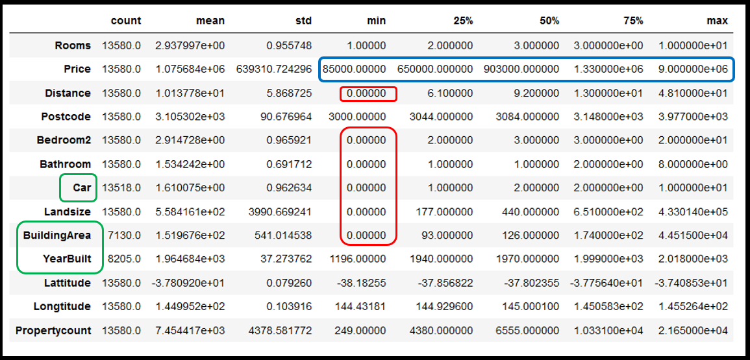
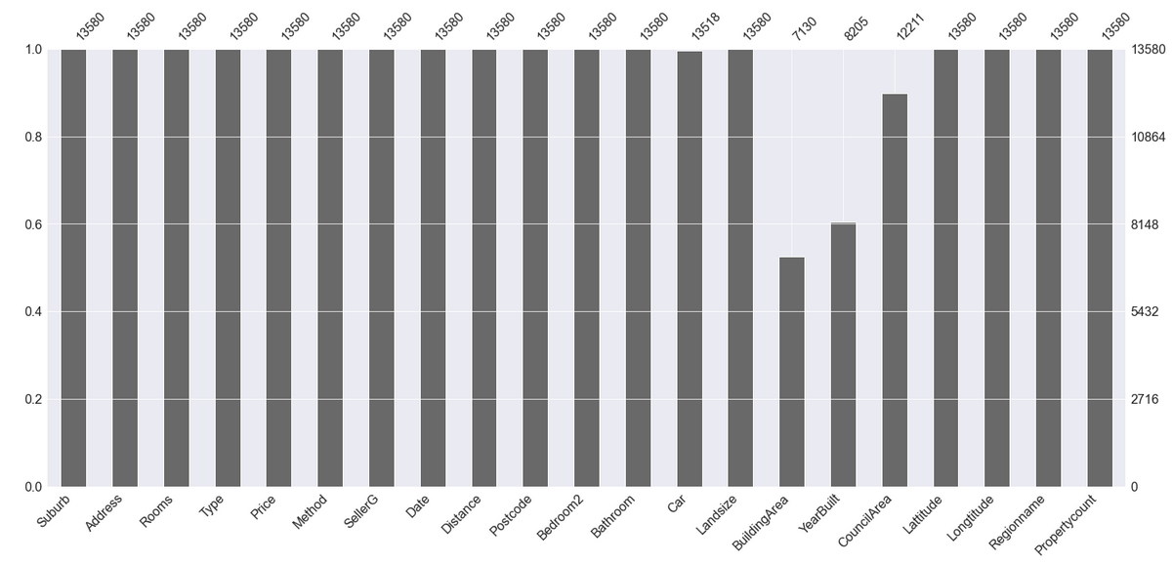
Data Challenges
Zero and outliers values
Missing values
Depending on property type and localization replaced with mean/median or left “0”
Considered luxury price segment as outliers
Depending on property type replaced with mean
“Build_Age” was created to replace "YearBuilt" missing values with mean

Slide 3
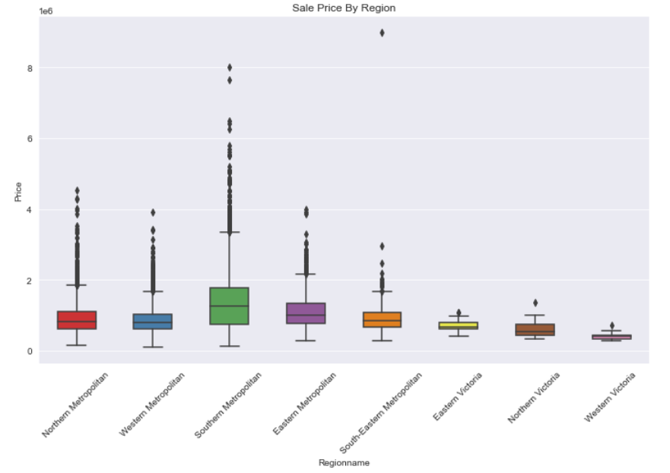
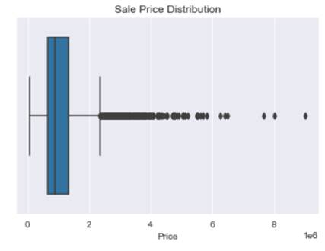
Price Distribution
The most houses are sold within 2,25M range
The region seems to influence the price

Slide 4
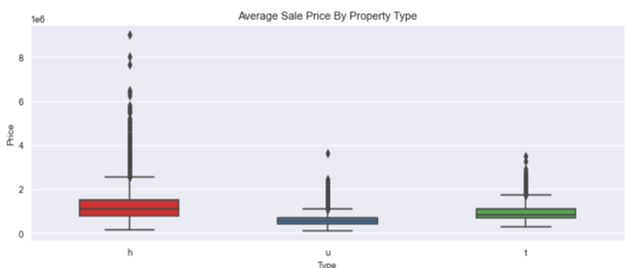
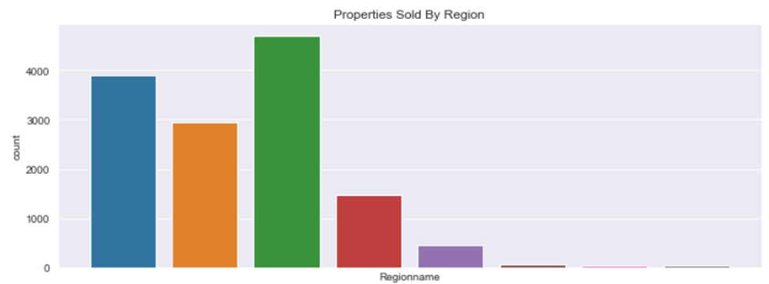
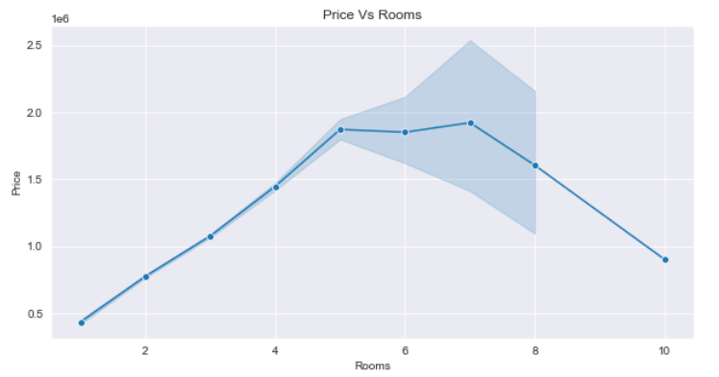
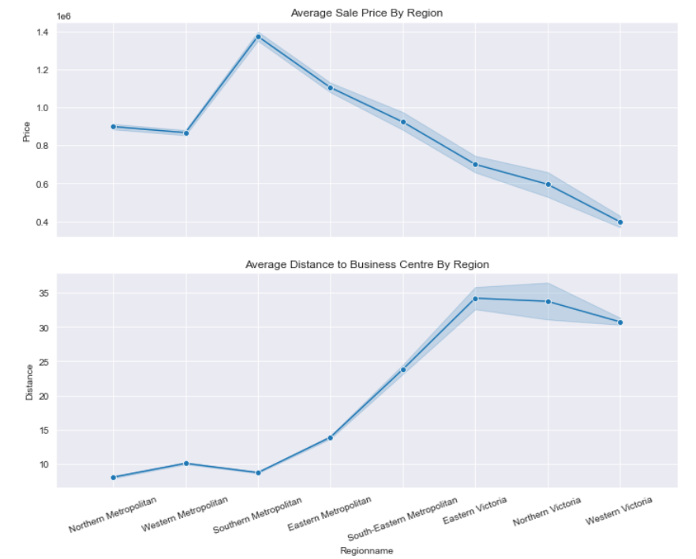
Price Influencers
Four sale leaders (regions) are located within 20 kms of city business centre
“More rooms-higher price” is true until it gets 5
House-type has the highest average price, the unit-type has the lowest, and the townhouse-type is in between

Slide 5
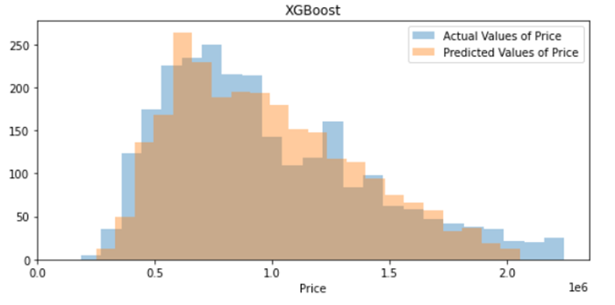
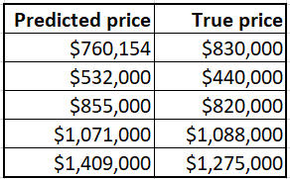

Final Model
Prediction Accuracy – 82%
Average error – $185,000
Main price influencers:
Distance to the business center
Landsize of the property
Building area
Number of rooms
What else can affect bidding
swimming pools
school district scores
crime count
floodplain
average property tax by location

